Slide 1

TRANSPORT
OKU BOOKING TRANSPORT

Slide 2


PROJECT DESCRIPTION
OKU BOOKING TRANSPORT

Slide 3




Addressing Challenges for Persons with Disabilities
This project aims to create an efficient booking system tailored for Persons with Disabilities (OKU) in Kuala Terengganu, enhancing accessibility and inclusivity in public transportation options.
Key Components of Our System
This project utilizes a robust technology stack, including React.js for the frontend, PHP APIs for the backend, and MySQL for secure data storage, ensuring an efficient and accessible platform.

Slide 4

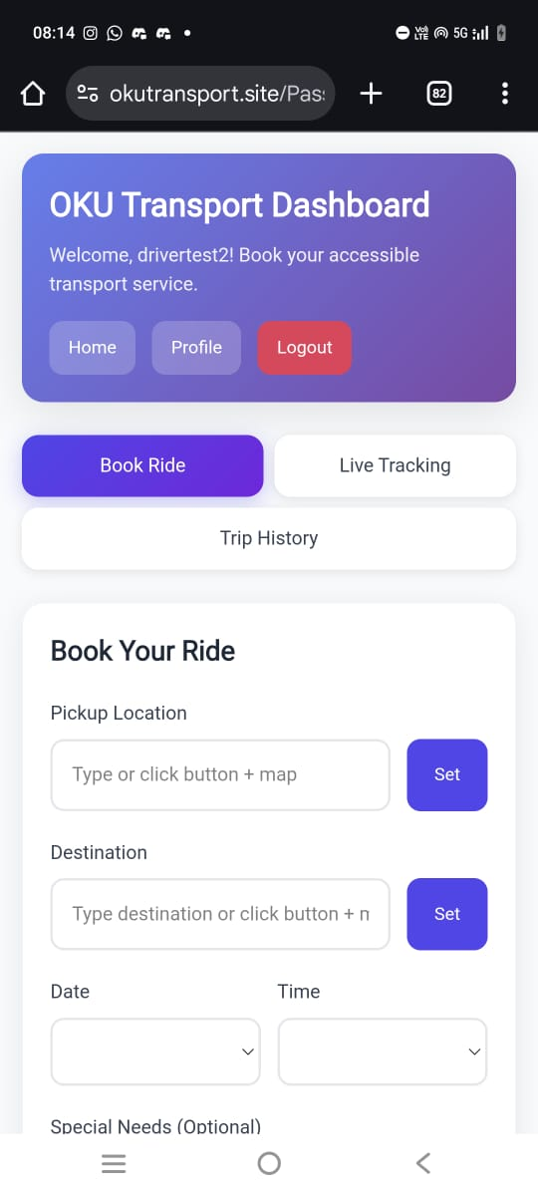
MULTI-ROLE ACCESS
Let’s see 
01
Key features
Secure registration & login
Book accessibility-tailored rides
Passenger (OKU User)
Live GPS tracking & real-time ETA

Slide 5

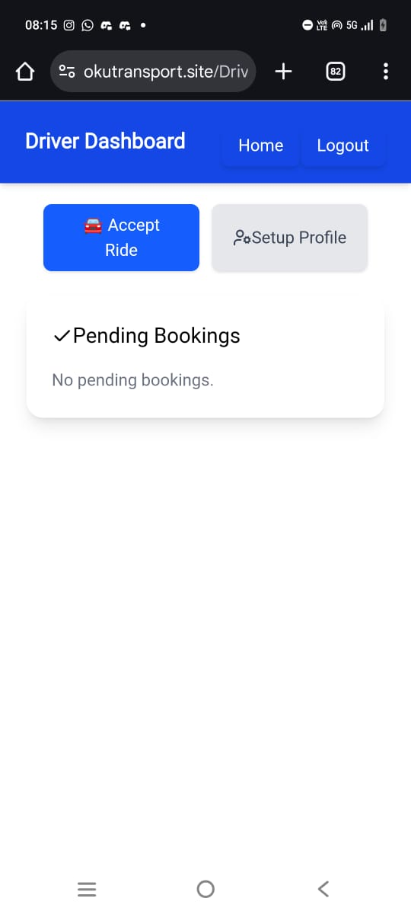
MULTI-ROLE ACCESS
Let’s see 
02
Key features
Accept & manage ride requests
Accessibility sensitivity training
Driver
Deliver reliable, respectful service

Slide 6

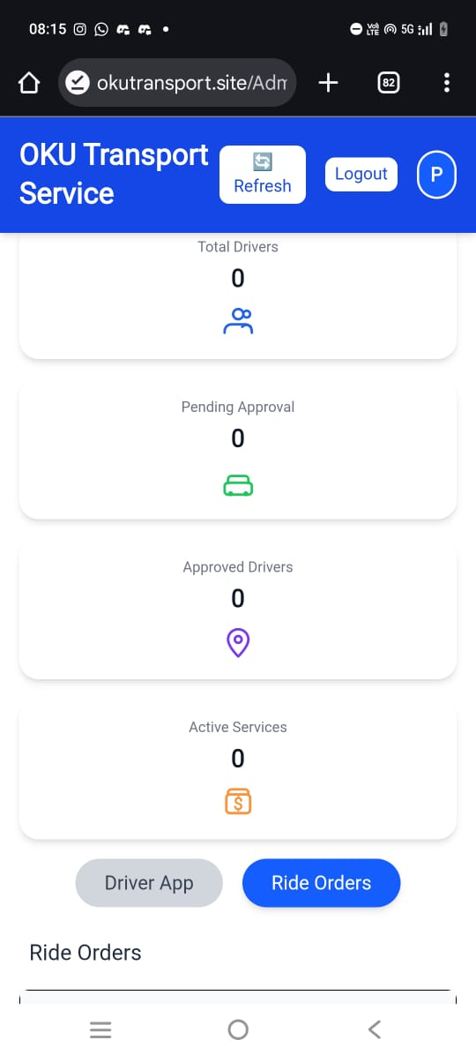
MULTI-ROLE ACCESS
Let’s see 
03
Key features
Oversee system operations
Manage users & compliance
Admin (JKM Officer)
Maintain accessibility standards

Slide 7
PROBLEM STATEMENT
OKU BOOKING TRANSPORT

Slide 8


THE
CHALLENGES
Persons with disabilities (OKU) in Kuala Terengganu face significant barriers to transportation. Current ride-hailing services lack accessibility features, drivers aren't equipped to handle special mobility needs, and passengers struggle with unclear communication about vehicle accessibility. Real-time tracking is unavailable, increasing anxiety during trips. Government coordination remains fragmented.

Slide 9
Accessibility Barriers
No Real-Time Tracking
OKU passengers have difficulty finding vehicles equipped with wheelchair ramps or mobility aids.
Passengers experience stress because they can’t see where their driver is or when they will arrive.
Communication Gaps
Drivers are often unaware of passengers’ special needs, leading to mismatched or unsuitable services
Weak Coordination
Limited OKU Features in Apps
Government and service agencies don’t coordinate efficiently, slowing down OKU transport support
Current ride-hailing platforms lack OKU-friendly options and government supervision.

Slide 10
OBJECTIVES
OKU BOOKING TRANSPORT

Slide 11

Our
Solution
OKU Booking Transport is a purpose-built, government-supervised platform connecting OKU passengers with verified accessible vehicles and trained drivers. Multi-role access ensures seamless experiences across passenger, driver, and JKM administrative perspectives. Real-time GPS tracking, ETA visibility, and accessibility-based vehicle selection put control back in passengers' hands.

Slide 12
Independent Booking for OKU Users
Real-Time GPS Tracking
Accessibility-Based Vehicle Selection
Enable at least 80% of OKU passengers to make bookings on their own
Show live driver location and estimated arrival time to reduce passenger anxiety
Let users choose vehicles that match their mobility needs (e.g., wheelchair-accessible)
Easy Ride Management for Drivers
JKM Admin Dashboard
Transparent Booking History
Help drivers view, accept, and manage OKU ride requests efficiently
Allow JKM administrators to oversee users, bookings, and drivers from one system
Keep records of all trips for safety, accountability, and monitoring.

Slide 13
METHODOLOGY
OKU BOOKING TRANSPORT

Slide 14
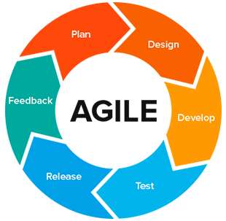
APPROACH
Agile development with iterative sprints & feedback

Slide 15
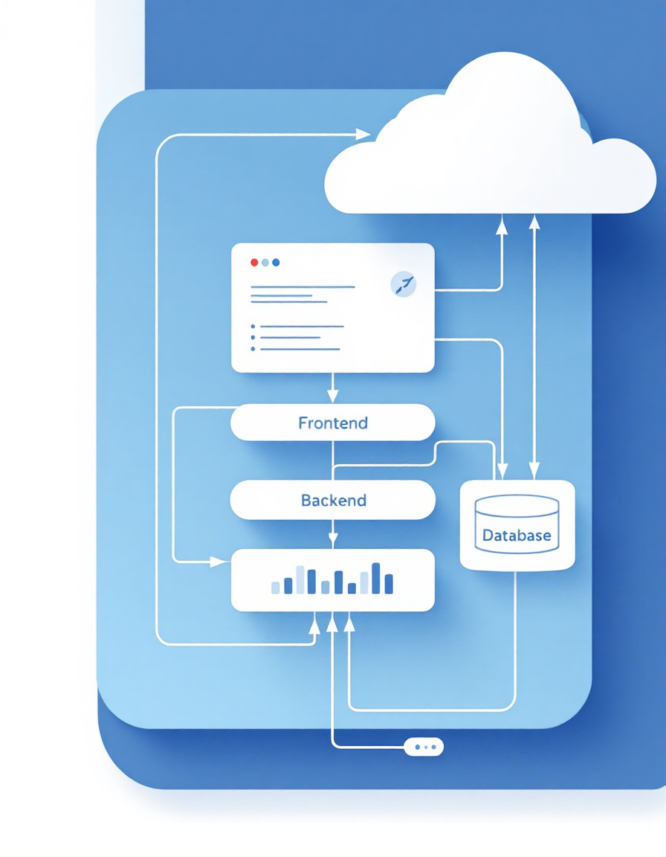
01
Frontend (React.js)
Responsive dashboards for passengers, drivers, admins. Tailwind CSS for accessibility-first UI.
Technical Foundation: Built for Scale & Reliability
02
Backend (PHP APIs)
Login, booking, driver management, real-time location endpoints. Secure authentication & approval workflows.

03
Database (MySQL)
User profiles, booking records, live location data. Integrated with Leaflet.js mapping.

Slide 16

GOVERNANCE
Only approved drivers can accept rides.
JKM officers oversee driver approval and service quality.

Slide 17
APPLICATION SIGNIFICANCE & BENEFITS
OKU BOOKING TRANSPORT

Slide 18
80%
100%
24/7
ALL
Independent Booking
Real-Time Visibility
Accessibility
Transparency
On-demand transportation anytime, with matching vehicle options
Complete booking history and government oversight for accountability
OKU users empowered to arrange transportation autonomously
Live GPS tracking eliminates uncertainty and anxiety

Slide 19
MARKETPLACE & CONCLUSION
OKU BOOKING TRANSPORT

Slide 20

Mainstream ride-hailing platforms lack:
Accessibility-first design
Government oversight & accountability
Transparent driver verification
OKU-specific features
THE GAP
Market Opportunity & Competitive Advantage
OKU Booking delivers:
Verified drivers trained for accessibility
JKM-supervised quality control
Vehicle selection by accessibility needs
Scalable to multi-language & payments

OUR UNIQUE VALUE

Slide 21

INCLUSIVE MOBILITY
STARTS HERE
The OKU Booking System transforms accessible transport from a privilege into a guarantee. By combining accessibility-first design, real-time transparency, and government-backed governance, we empower Persons with Disabilities to move independently, safely, and with dignity throughout Kuala Terengganu.
Next Steps:
Pilot phase with drivers and OKU users. Gather feedback. Scale with multi-language support and expanded payment options.

